Slide 1







Running with Tiny bit
CarRun
Yahboom

Slide 2







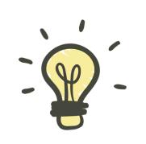
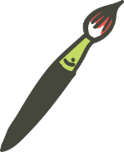
Contents
Preparation
Learning goal
Search for blocks
Combine blocks
Experimental phenomena
Yahboom

Slide 3

Preparation
The position of the motor on the robot car
Programming method:
Mode 1 online programming: First, we need to connect the micro:bit to the computer by USB cable. The computer will pop up a USB flash drive and click on the URL in the USB flash drive: http://microbit.org/ to enter the programming interface. Add the Yahboom package: https://github.com/YahboomTechnology/Tiny-bitLib to program.
Mode 2 offline programming: We need to open the offline programming software. After the installation is complete, enter the programming interface, click【New Project】, add Yahboom package: https://github.com/YahboomTechnology/Tiny-bitLib, you can program.
Yahboom

Slide 4
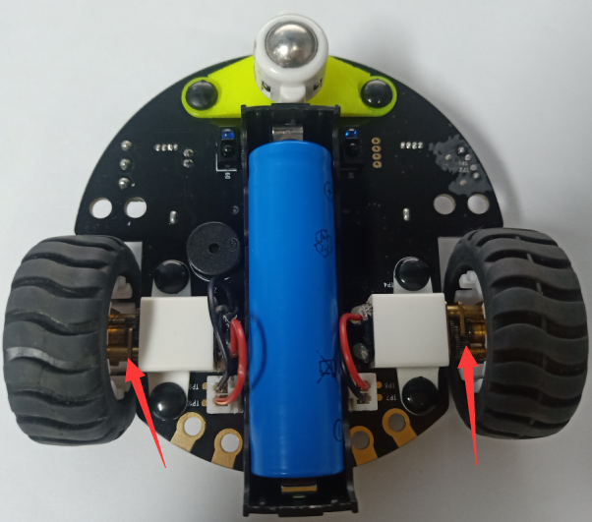
Preparation
As shown in the figure below, the red arrow points to the Tiny-bit motor.
Yahboom

Slide 5
Learning goal
1.Learn how to use control motor graphically program building blocks
2.In this lesson, we will learn how to control direction of the car
Yahboom

Slide 6

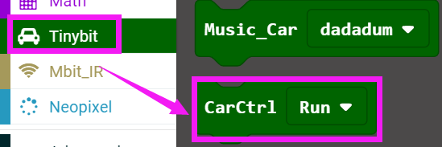
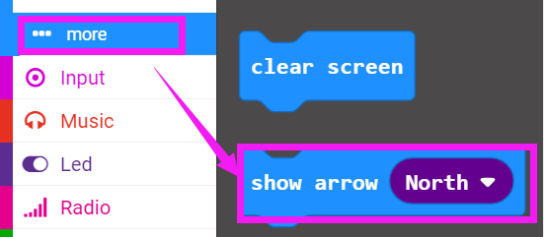
Search for block
The following is the location of the building blocks required for this programming.
Yahboom

Slide 7
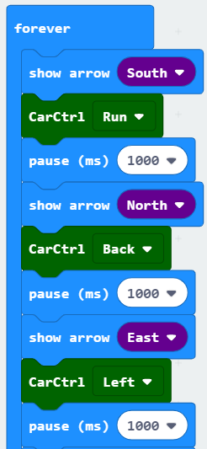
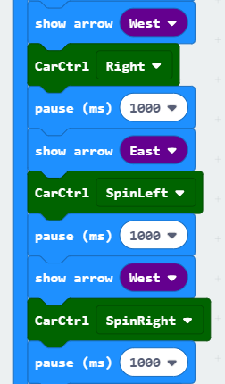
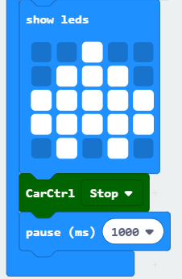
Combine block
The summary program is shown below:
Yahboom

Slide 8
Experimental phenomena
After the program is downloaded, we can see that the robot car will advance 1s, back 1s, turn left 1s, turn right 1s, spin left 1s, spin right 1s, stop 1s.
Yahboom

Slide 9
Inspire Creativity Embrace Innovation
Thank you!!!

